Slide 1

PMS 5.0
PDF Merge and Split _{(Ver 5.0)}
Designed and Developed
By
Vivek K (Inst)

Slide 2
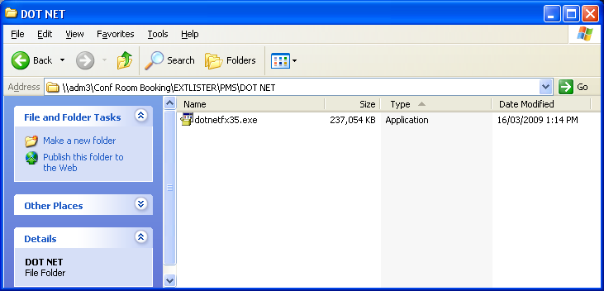
How to Install ?
Step 1:
PREREQUISITE
.NET framework 3.5 or higher
You Can find the setup for .NET Framework 3.5 in the following path.
\\adm3\Conf Room Booking\EXTLISTER\PMS\DOT NET
However you can get this from IT Dept also
Anyway Admin Rights are required to install this .NET framework. So please request IT-Dept for installing this suite.
In some PC this might have been installed already.

Slide 3
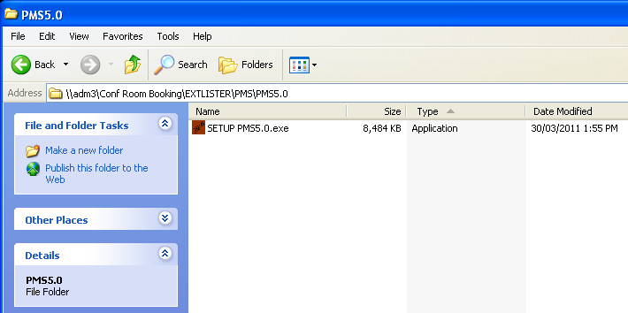

Step 2:
Admin Rights are not required to install the following setup. All you should have is a folder with write access permission to your login account.
Find the setup for PMS 5.0 in the following path
\\adm3\Conf Room Booking\EXTLISTER\PMS\PMS5.0
Installer (Setup)

Slide 4
WHAT IS NEW IN PMS 5.0 ?

Slide 5
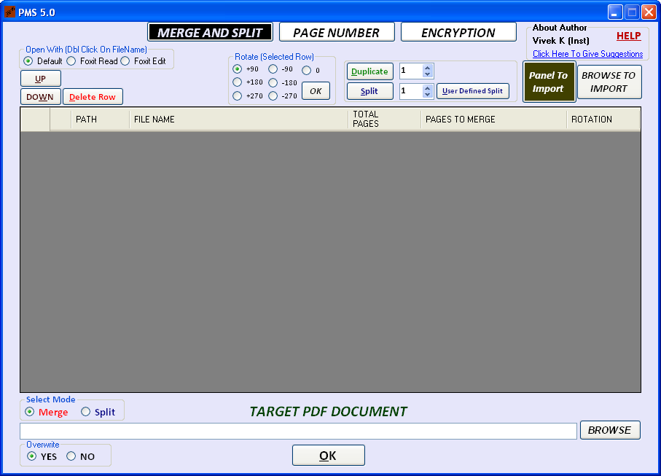
WHAT IS NEW IN PMS 5.0 ?
PAGE ROTATE OPTION IN MERGE&SPLIT TAB

Slide 6
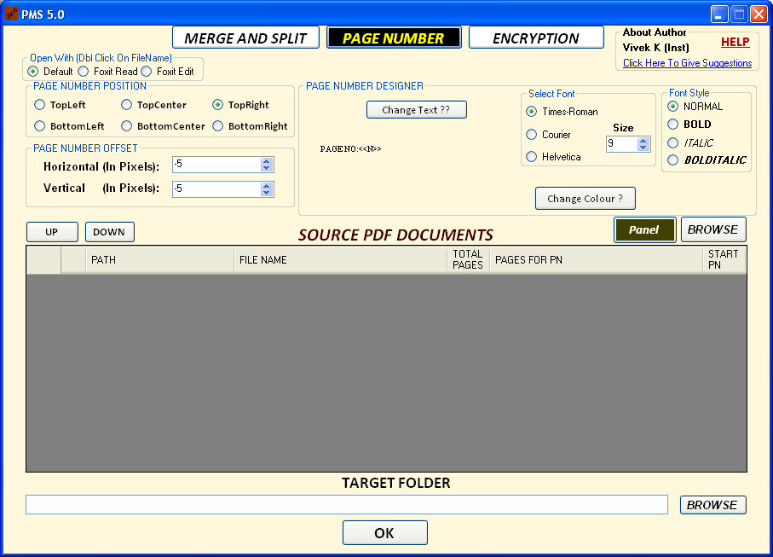
WHAT IS NEW IN PMS 5.0 ?
BUG FIXED, IN THE PREVIOUS VERSION PAGE NUMBERING (NOW IT WILL WORK SEAMLESSLY WITH SCANNED PAGES)

Slide 7
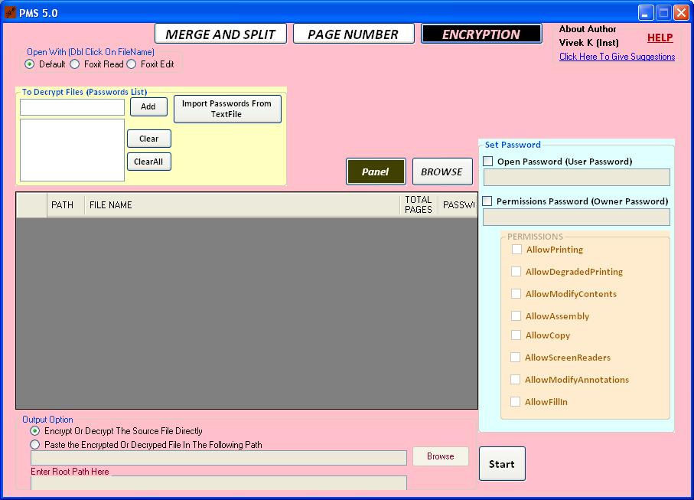
WHAT IS NEW IN PMS 5.0 ?
A new tab has been added for encryption/decryption related activities. The following tasks can be done using this tool
1.Applying ,updating or removing password for bunch of pdf files at one shot.
2.Brute force attack is inbuilt into it.(Press Ctrl+Alt+b to unveil). Although It can’t be used for security threat because person at least should know the most frequently usable keys, otherwise it will take years together to undo the password)

Slide 8

TOOL 1

Slide 9



USING PAGE ROTATE OPTION IN MERGE&SPLIT TAB
OUTPUT
AR1234.pdf
Suppose you have the following two PDF files with two pages
AR12.pdf
AR34.pdf
PMS 5.0
+180⁰ Rotation
-90⁰ Rotation

Slide 10

STEP1:Drag Both The Files into grid (you can do the same thing using panel to import also)

Slide 11
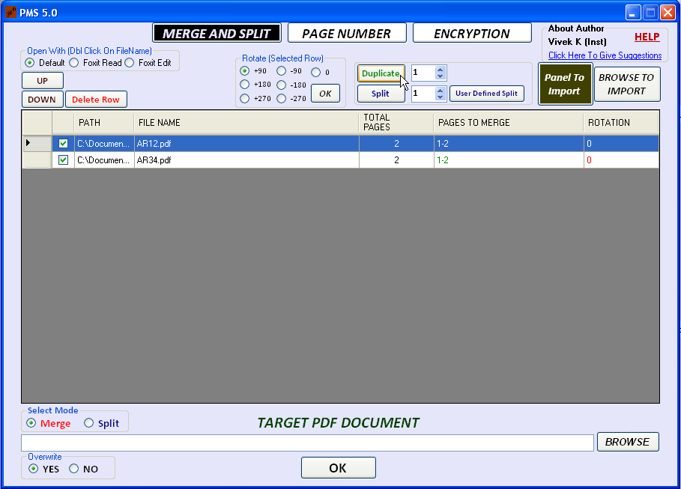
Select The First Row(AR12.pdf)
Click Duplicate
If you double click here, the file will be launched in your selected application
Foxit Reader 4.3 and Foxit Editor 2.0 are commingled with PMS 5.0
Using
1.Foxit Reader we can add annotations(Text comments,clouds,etc) in pdf files.
2.Foxit Editor we can edit the pdf files seamlessly

Slide 12
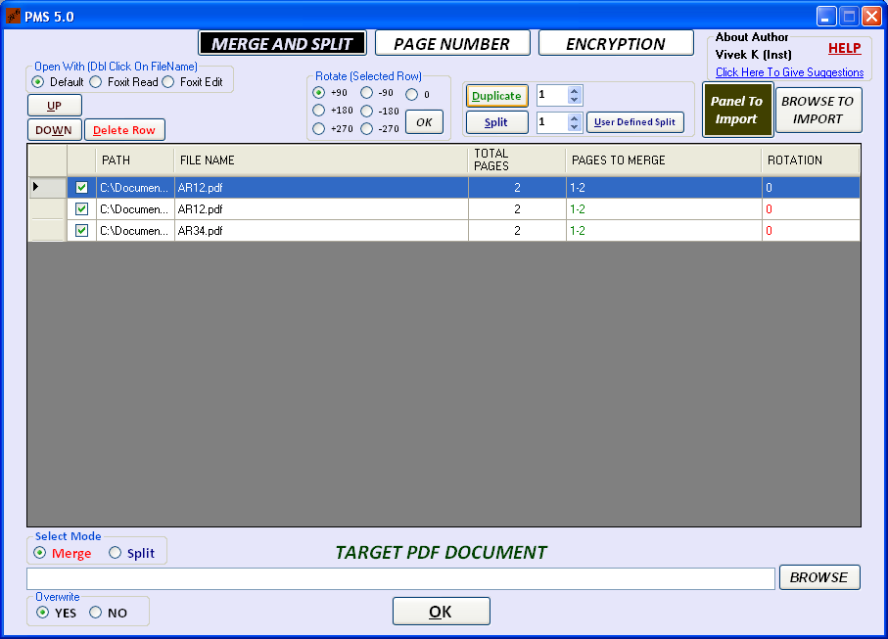
Now the first row is get duplicated

Slide 13
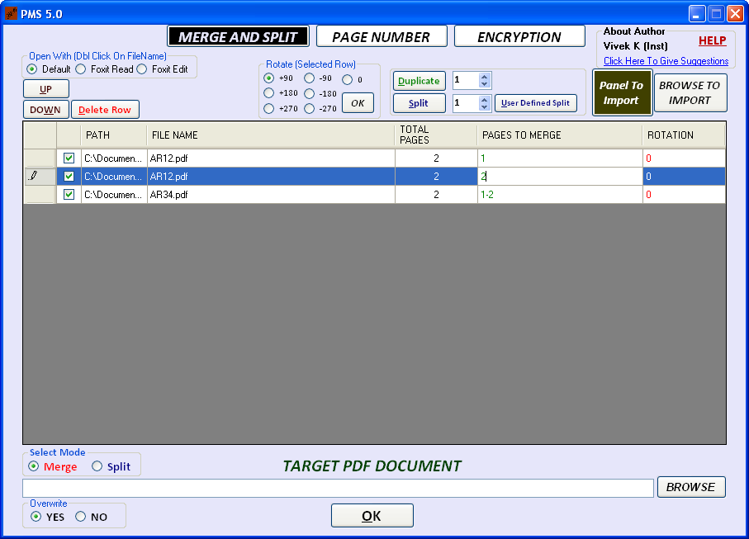
Now enter 1 in the first row, enter 2 in the second row

Slide 14
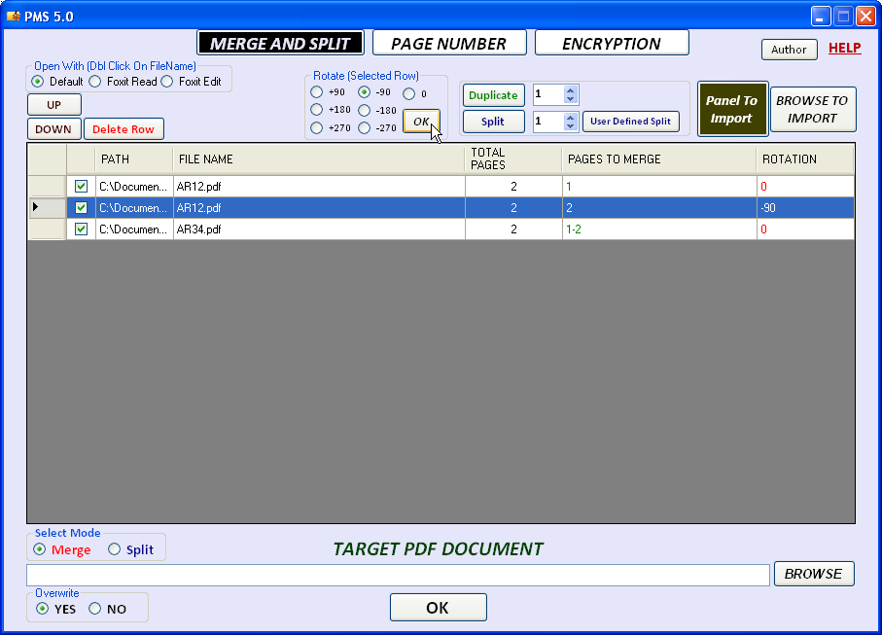
Select The 2nd Row.
Then Select -90 Click Ok

Slide 15
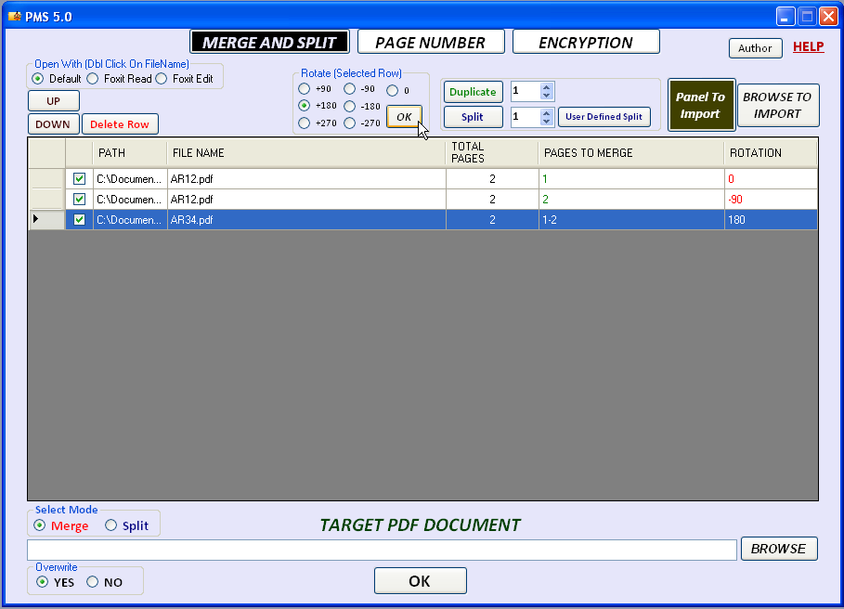
Similarly Select The 3rd Row.
Then Select +180 Click Ok

Slide 16
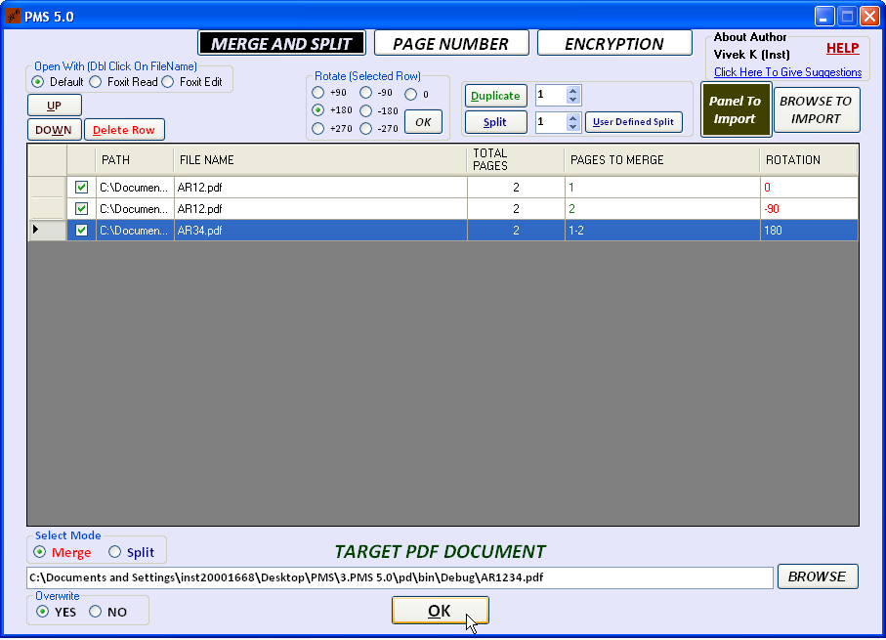
Browse for the output file name.
You can use on of the following way to give file name
(1.You can directly type in the textbox
2.You can use Browse button
3.You can drag drop the file on textbox)

Slide 17
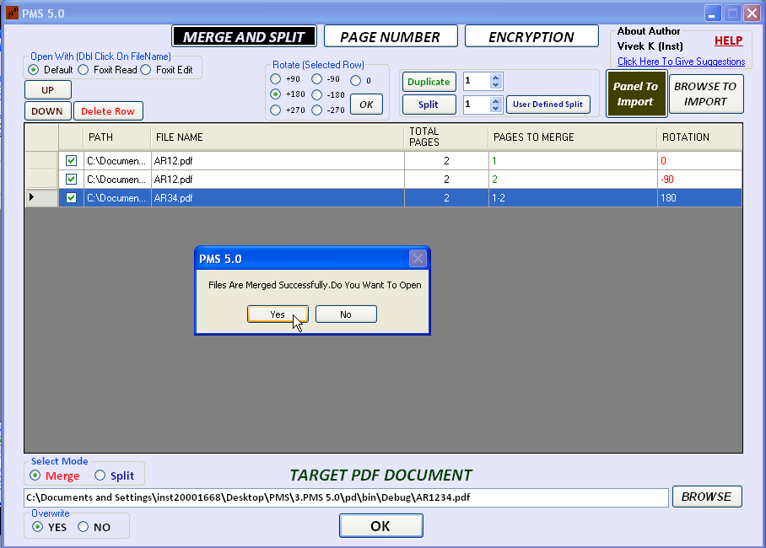
Now the file will open in your default viewer. However You can open in Foxit Reader Or Editor by selection

Slide 18

You Will get this required output

Slide 19
TOOL 2

Slide 20
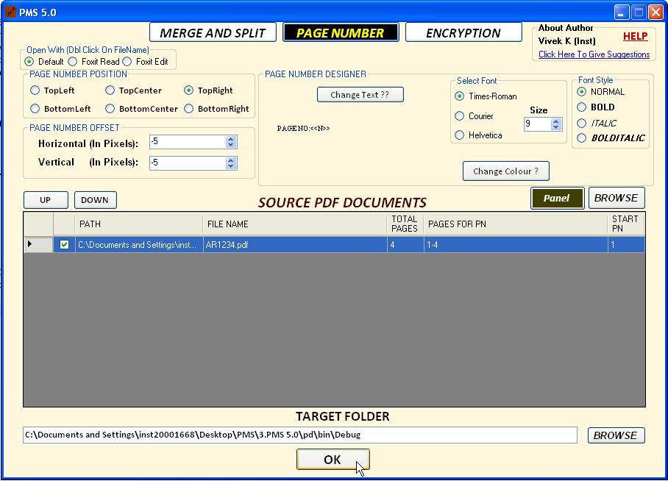

Slide 21

Page numbers are added Successfully in all the pages.
The following properties are
Variable
Font, Font-Size
Position
Text

Slide 22
TOOL 3

Slide 23
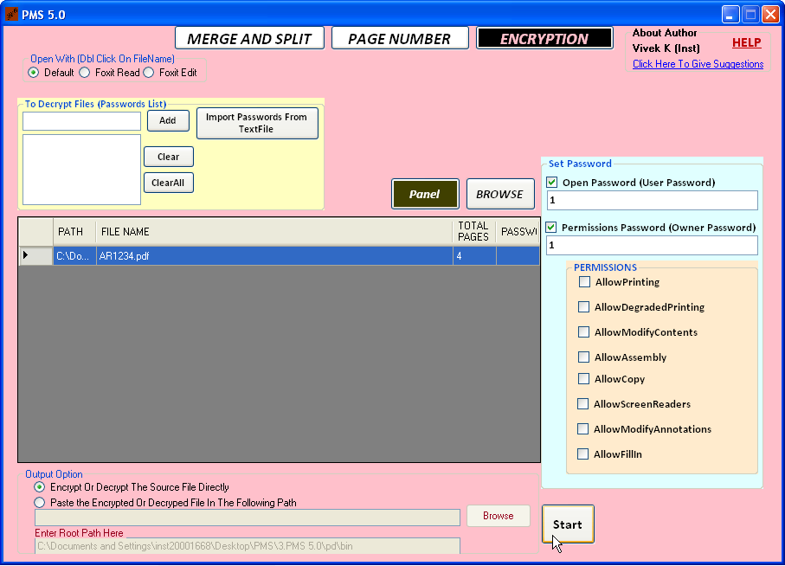
In case if files are already encrypted then those passwords are to be added here before drag and drop the files
You can remove the passwords by removing the checking in these two password options
You can allow the list of permissions by checking here

Slide 24
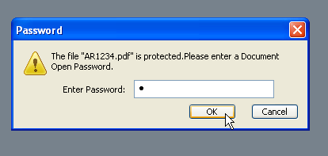
Now the password protected PDF file is ready.
For More information about this tool and brute force attack, contact author.

Slide 25
DROP YOUR SUGGESTIONS HERE


Slide 26
Thank You !

